Slide 1
Data Modeling Using the Entity-Relationship Model

Slide 2
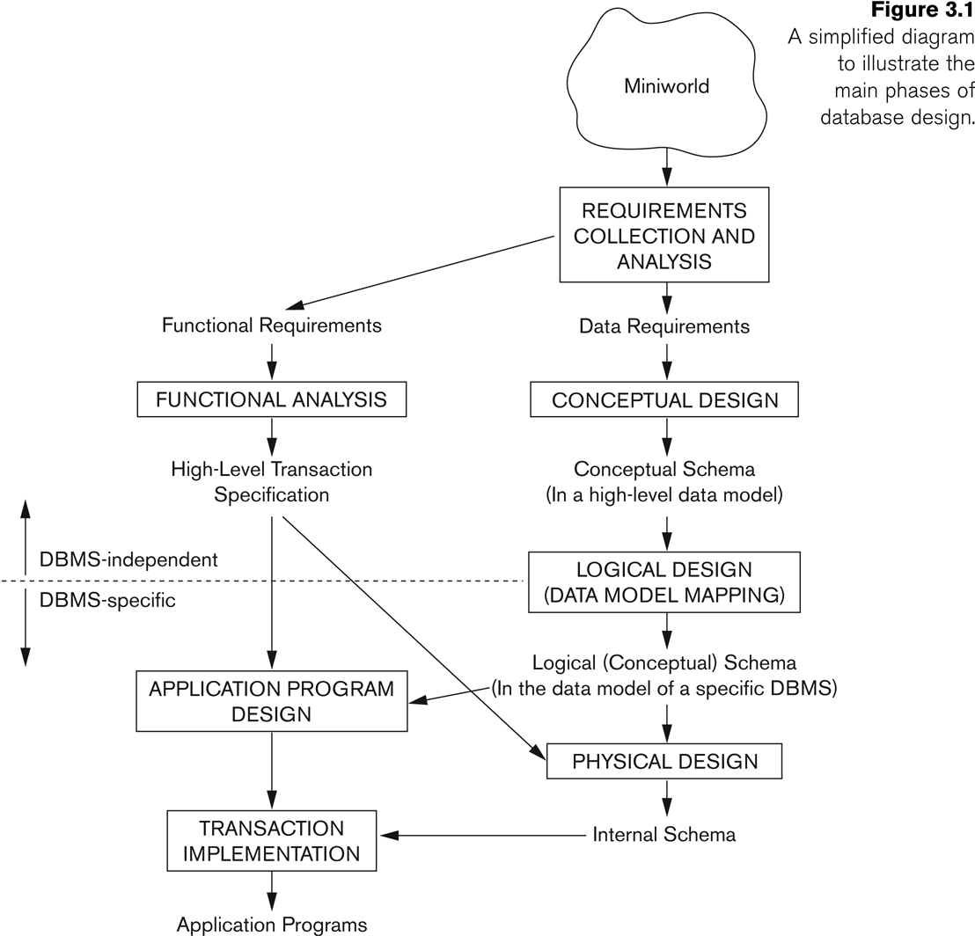
Database Design Process

Slide 3
ER Model Concepts
Entities
specific objects in the mini-world.
E.g. EMPLOYEE John , Research DEPARTMENT
Attributes
They are properties used to describe an entity.
Each attribute has a data type
E.g. integer, string, subrange, enumerated type, …

Slide 4
Types of Attributes
Simple
Each entity has a single atomic value for the attribute. For example, SSN or Sex.
Composite
The attribute is composed of several components. For example:
Address(House#, Street, City, State, ZipCode, Country),
Name(FirstName, MiddleName, LastName).
Multi-valued
An entity may have multiple values for that attribute. For example:
PreviousDegrees of a STUDENT.
Stored and Derived
Null Values

Slide 5
Types of Attributes
Complex attribute - The composite and multi-valued attributes may be nested arbitrarily to any number of levels,
For example, PreviousDegrees of a STUDENT is a composite multi-valued attribute denoted by {PreviousDegrees (College, Year, Degree, Field)}
Multiple PreviousDegrees values can exist
Each has four subcomponent attributes:
College, Year, Degree, Field

Slide 6
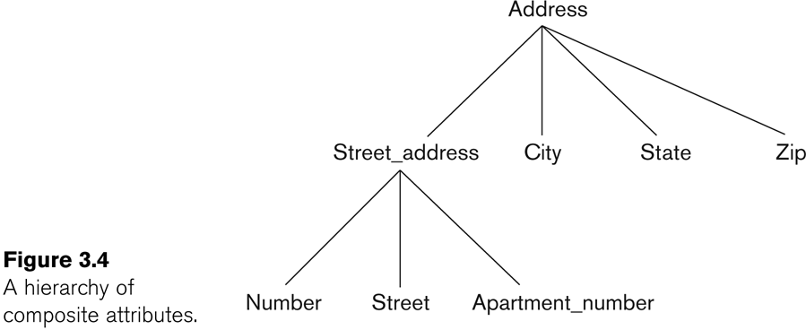
Example of a composite attribute

Slide 7
Entity Types and Key Attributes
Entities with the same basic attributes are grouped into an Entity type.
For example, the entity type EMPLOYEE and PROJECT.
Key attribute
For example, SSN of EMPLOYEE.

Slide 8
Key Attributes
A key attribute may be composite.
VehicleTagNumber is a key of the CAR entity type with components (Number, State).
An entity type may have more than one key.
The CAR entity type may have two keys:
VehicleId (popularly called VIN)
VehicleTagNumber (Number, State), aka license plate number.
Each key is underlined

Slide 9
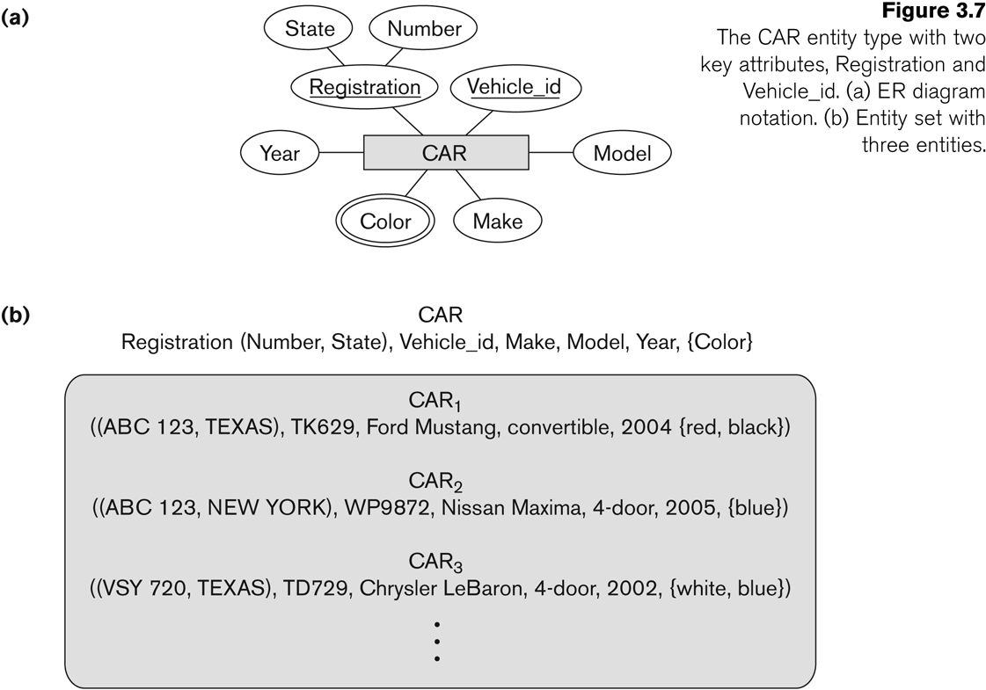
Entity Type CAR with two keys and a corresponding Entity Set
Entity set is the current state of the entities that is stored in the database

Slide 10
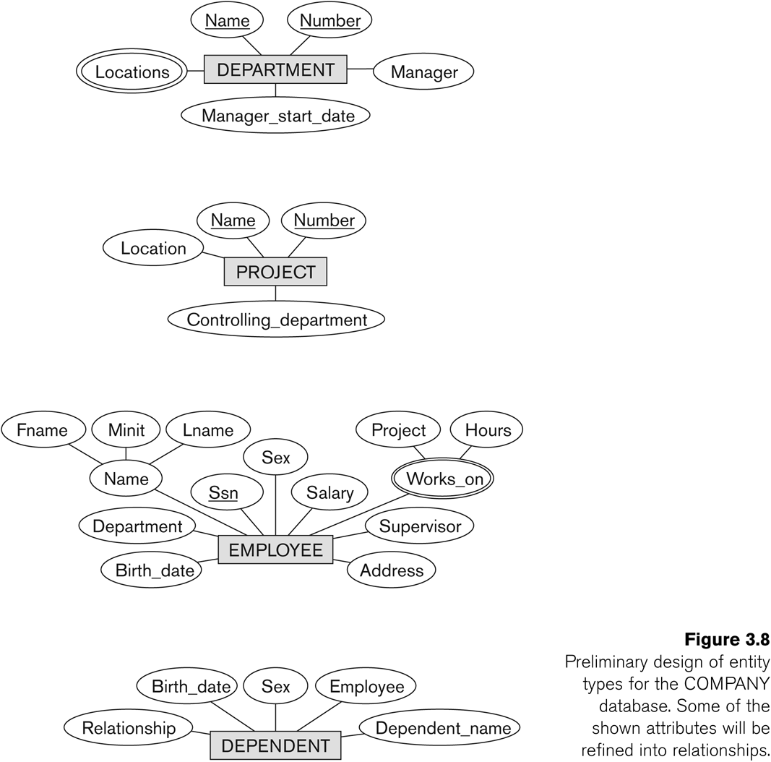
Initial Design of Entity Types: EMPLOYEE, DEPARTMENT, PROJECT, DEPENDENT
Entity types in the COMPANY database:
DEPARTMENT
PROJECT
EMPLOYEE
DEPENDENT

Slide 11
Refining the initial design by introducing relationships
Some aspects in the requirements will be represented as relationships
ER model has three main concepts:
Entities (and their entity types and entity sets)
Attributes (simple, composite, multivalued)
Relationships (and their relationship types and relationship sets)

Slide 12
Relationships
A relationship relates two or more distinct entities with a specific meaning.
For example, EMPLOYEE John works on the ProductX PROJECT,
EMPLOYEE Franklin manages the Research DEPARTMENT.
Relationships of the same type are grouped into a relationship type.
Degree of a relationship type is the no of participating entity types.
Both MANAGES and WORKS_ON are binary relationships.

Slide 13
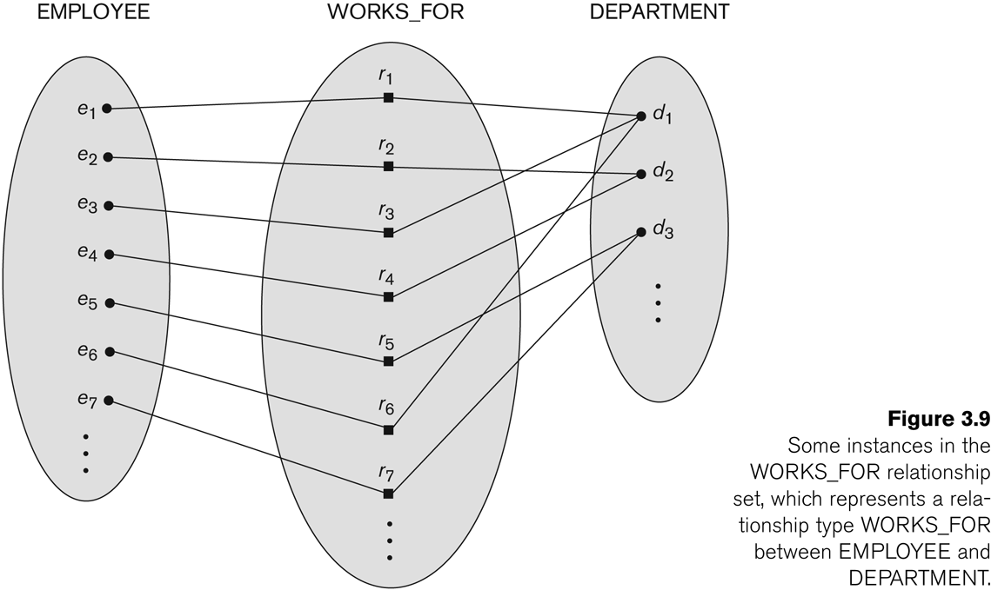
Relationship instances of the WORKS_FOR N:1 relationship between EMPLOYEE and DEPARTMENT

Slide 14
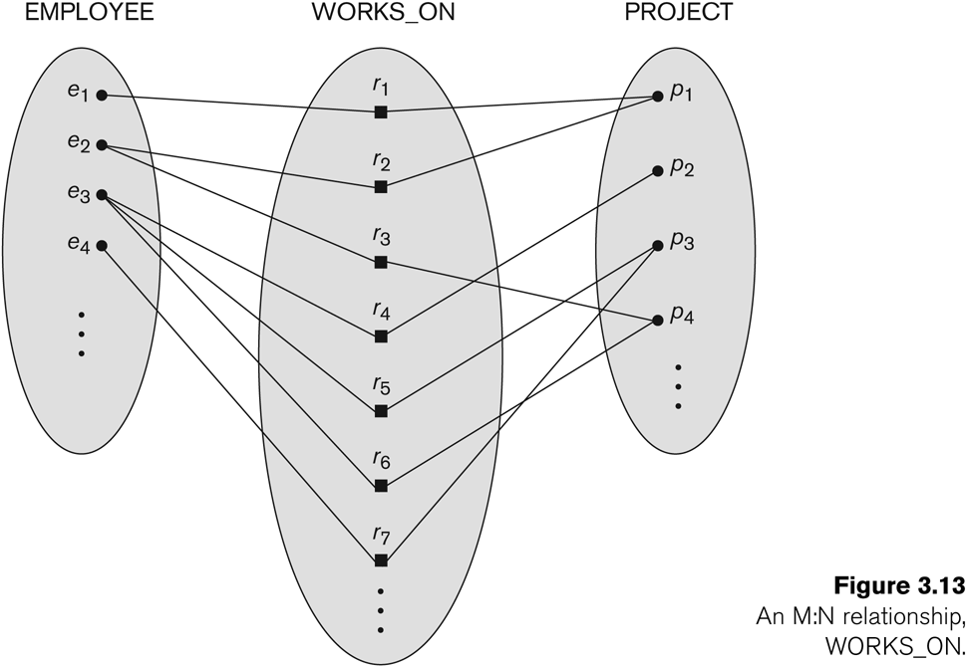
Relationship instances of the M:N WORKS_ON relationship between EMPLOYEE and PROJECT

Slide 15
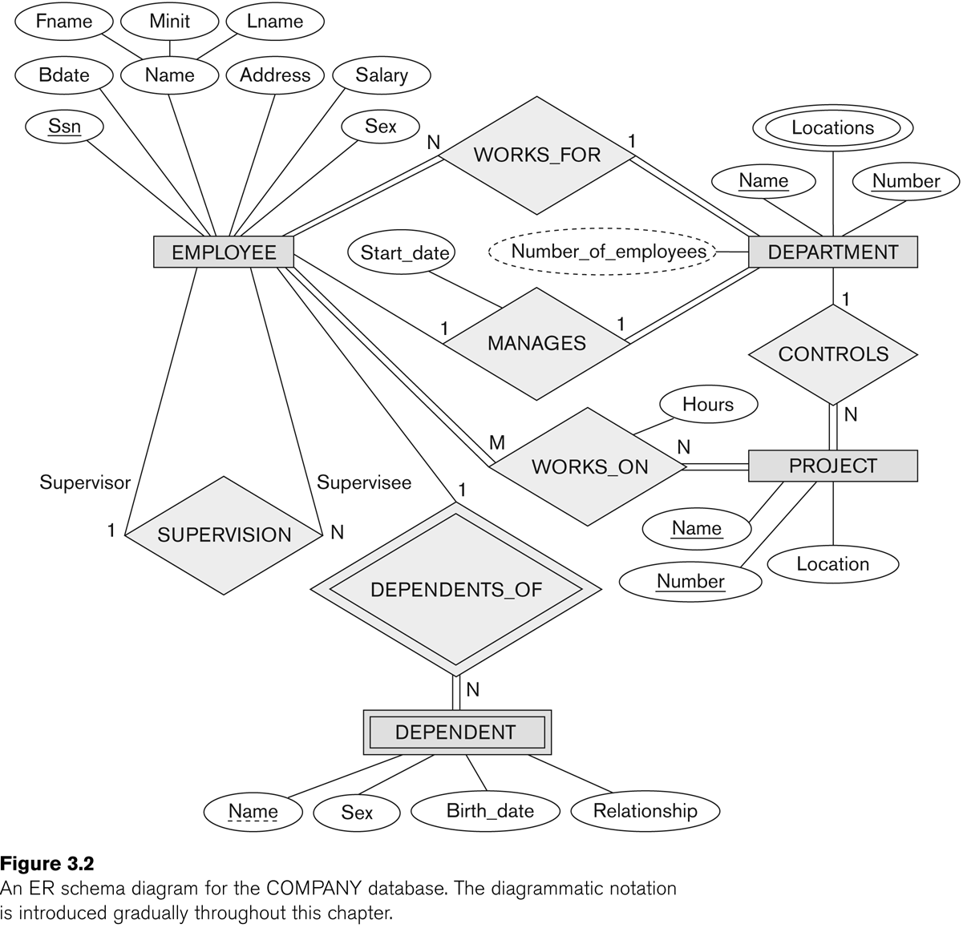
Relationship type vs. relationship set
Relationship Type:
Is the schema description of a relationship
Identifies the relationship name and the participating entity types
Also identifies certain relationship constraints
Relationship Set:
The current state of a relationship type

Slide 16
COMPANY database: relationships
Six relationship types are identified
All are binary relationships( degree 2)
WORKS_FOR (between EMPLOYEE, DEPARTMENT)
MANAGES ( between EMPLOYEE, DEPARTMENT)
CONTROLS (between DEPARTMENT, PROJECT)
WORKS_ON (between EMPLOYEE, PROJECT)
SUPERVISION (between EMPLOYEE (as subordinate), EMPLOYEE (as supervisor))
DEPENDENTS_OF (between EMPLOYEE, DEPENDENT)

Slide 17
ER DIAGRAM – Relationship Types are: WORKS_FOR, MANAGES, WORKS_ON, CONTROLS, SUPERVISION, DEPENDENTS_OF

Slide 18
Weak Entity Types
An entity that does not have a key attribute
A weak entity must participate in an identifying relationship type with an owner or identifying entity type
Entities are identified by the combination of:
Partial key of the weak entity type
The particular entity they are related to in the identifying entity type
Example:
A DEPENDENT entity is identified by
the dependent’s first name (partial key), and
the specific EMPLOYEE with whom the dependent is related

Slide 19
Constraints on Relationships
Constraints on Relationship Types (ratio constraints)
Cardinality Ratio (specifies maximum participation)
One-to-one (1:1)
One-to-many (1:N) or Many-to-one (N:1)
Many-to-many (M:N)
Existence Dependency Constraint (specifies minimum participation) (also called participation constraint)
zero (optional participation, not existence-dependent)
one or more (mandatory participation, existence-dependent)

Slide 20
Many-to-one (N:1) Relationship

Slide 21
Many-to-many (M:N) Relationship

Slide 22
Recursive Relationship Type
EMPLOYEE participates twice in two distinct roles:
supervisor (or boss) role
supervisee (or subordinate) role
Each relationship instance relates two distinct EMPLOYEE entities:
One employee in supervisor role
One employee in supervisee role

Slide 23
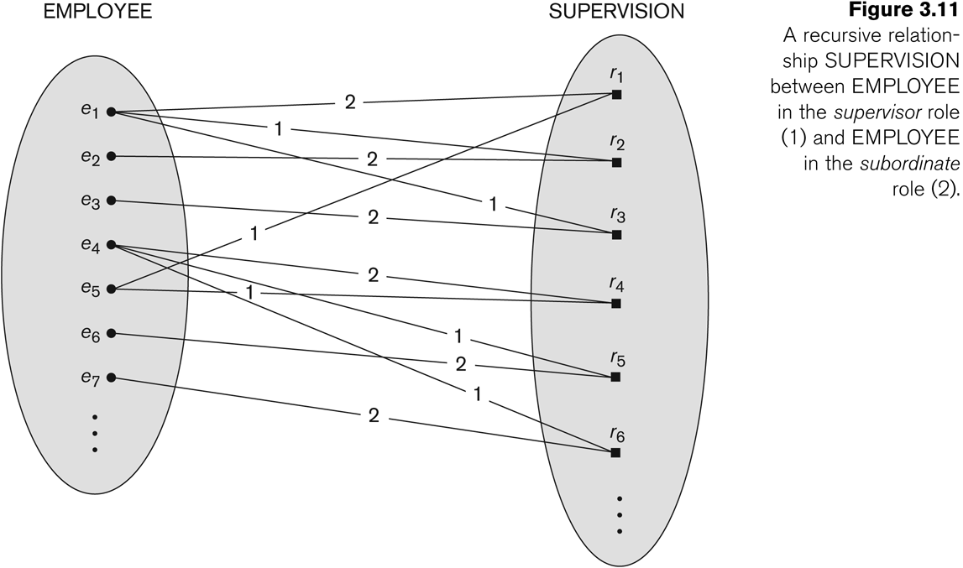
A Recursive Relationship Supervision`

Slide 24
Recursive Relationship Type is: SUPERVISION (participation role names are shown)

Slide 25
Attributes of Relationship types
A relationship type can have attributes:
For example, HoursPerWeek of WORKS_ON
A value of HoursPerWeek depends on a particular (employee, project) combination
Most relationship attributes are used with M:N relationships
In 1:N relationships, they can be transferred to the entity type on the N-side of the relationship

Slide 26
Example Attribute of a Relationship Type:
Participation Constraint : Total vs partial.
Cardinality Ratio:
1:N, 1:1, N:M

Slide 27
Steps to draw an ER diagram
Get problem description
Define Entities
Add Attributes
Specify Key, multiple, composite attributes
Add Relations
Specify Cardinality, total/partial relations
Iterate

Slide 28
Steps to draw an ER diagram
Essential to further design, but often given little care:
Is an entity a weak entity (key?)
Multivalued attributes
Derived attribute
Total/partial participation
Cardinality ratio

Slide 29
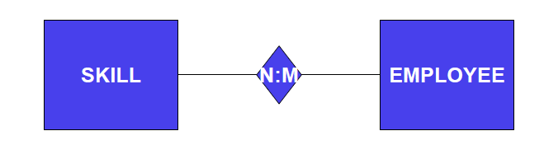
Examples
An employee may have several skills; and
A particular skill may be held by several employees

Slide 30
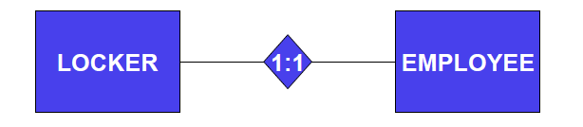
Example
An employee may have no more than one locker; and
A locker may only be accessible by one employee

Slide 31
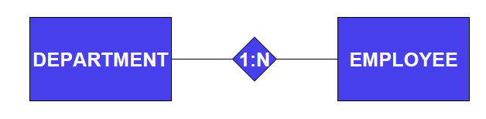
Example
An employee may only work for one department; and
A department has several employees

Slide 32
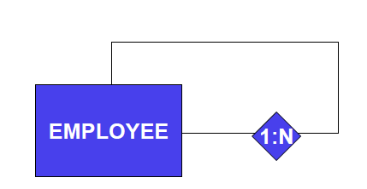
Example
An employee can have many colleagues

Slide 33

A building has many apartments
An apartment exists in only one building

Slide 34
Problem 1
Draw E\R model for the university database with the following requirements
The university keeps track of each student's name, rollno, SSN, current address and phone, permanent address and phone, birthdate, sex, class (freshman, sophomore, ..., graduate), major department, minor department (if any), and degree program (B.A., B.S., ..., Ph.D.). Some user applications need to refer to the city, state, and zip of the student's permanent address, and to the student's last name. Both SSN and Rollno have unique values for each student.
Each department is described by a name, code, office number, office phone, and college. Both name and code have unique values for each department.
Each course has a course name, description, course number, number of semester hours, level, and offering department. The value of course number is unique for each course.
Each section has an instructor, semester, year, course, and section number. The section number distinguishes different sections of the same course that are taught during the same semester/year; its values are 1, 2, 3, ...; up to the number of sections taught during each semester.
A grade report has a student, section, letter grade, and numeric grade (0, 1, 2, 3, 4 for F, D, C, B, A, respectively).

Slide 35
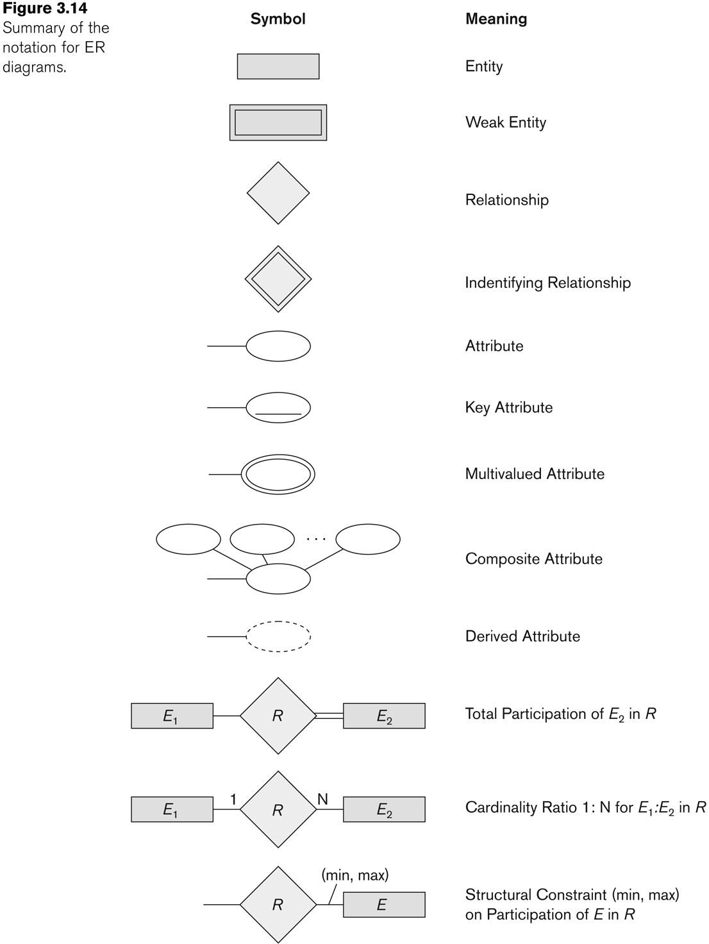
Alternative (min, max) notation for relationship Structural constraints:
Specifies that each entity e in E participates in at least min and at most max relationship instances in R
Default(no constraint): min=0, max=n
Must have min ≤ max, min ≥ 0, max ≥ 1
Derived from the knowledge of mini-world constraints

Slide 36
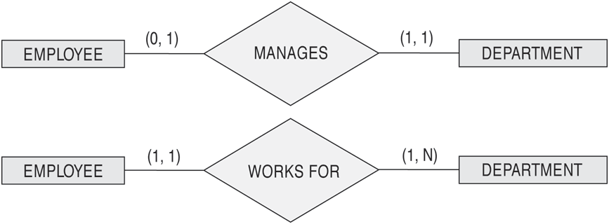
(min , max) notation for relationship constraints
A department has exactly one manager and an employee can manage at most one department.
Specify (0,1) for participation of EMPLOYEE in MANAGES
Specify (1,1) for participation of DEPARTMENT in MANAGES
Read the min,max numbers next to the entity type and looking away from the entity type

Slide 37
The (min,max) notation for relationship constraints
An employee can work for exactly one department but a department can have any number of employees.
Specify (1,1) for participation of EMPLOYEE in WORKS_FOR
Specify (1,n) for participation of DEPARTMENT in WORKS_FOR

Slide 38
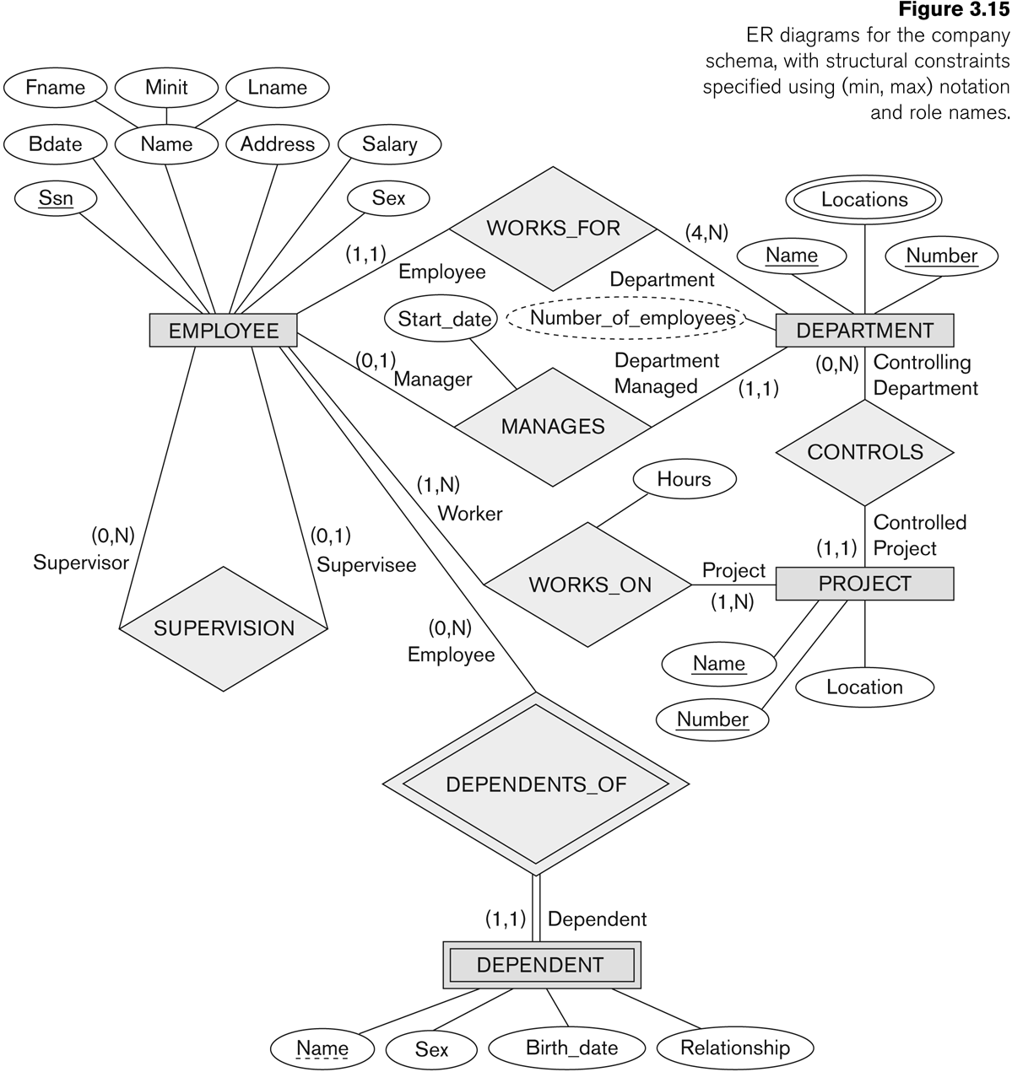
min, max - notation

Slide 39
notation for ER diagrams
Notes:
An identifying relationship is a relationship between two entities in which an instance of a child entity is identified through its association with a parent entity, which means the child entity is dependent on the parent entity for its identity and cannot exist without it.

Slide 40
Relationships of Higher Degree
Relationship types of degree 2 are called binary
Relationship types of degree 3 are called ternary and of degree n are called n-ary
Constraints are harder to specify for higher-degree relationships (n > 2) than for binary relationships

Slide 41
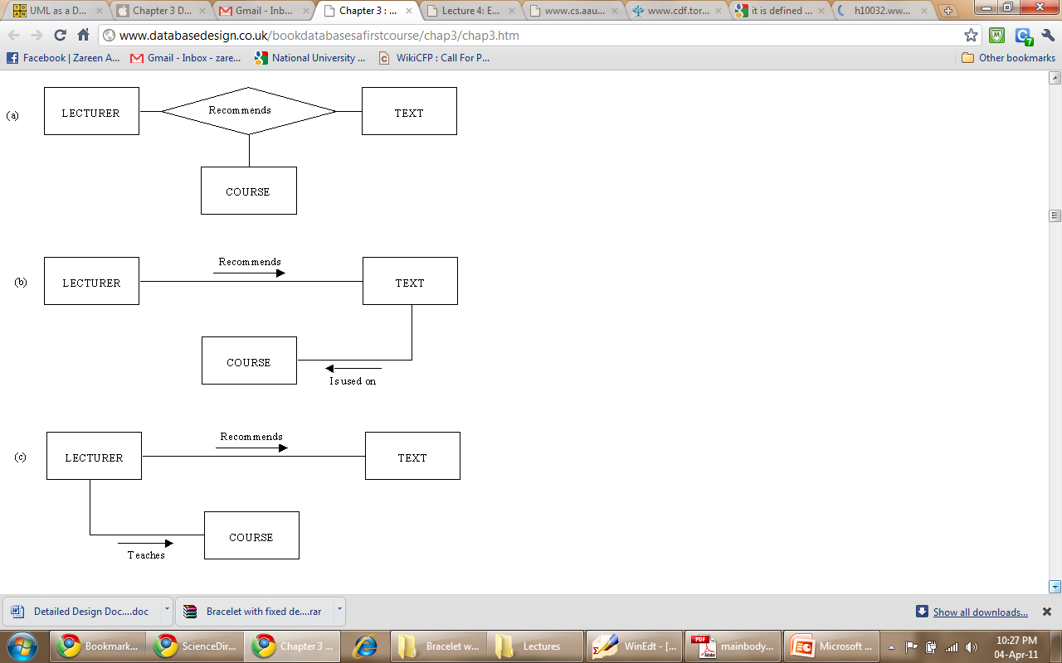
Example of a ternary relationship

Slide 42
Example of a ternary relationship
Notes:
LECTURERs 'recommend' TEXTs and TEXTs 'are_used_on' COURSEs. The fact that a lecturer recommends a text and that text is used on a course does not necessarily mean that that lecturer recommended that text for that course. The text might be used on the course and recommended by someone else, whereas our lecturer does recommend that text but for a different course.
In Fig. 3.8(c) it is possible to tell which texts a lecturer recommends and which courses he or she teaches on, but not which texts are used on a course or which courses use a given text. The fact that a lecturer recommends a text and teaches a course does not imply that he or she recommends that text for that course.

Slide 43
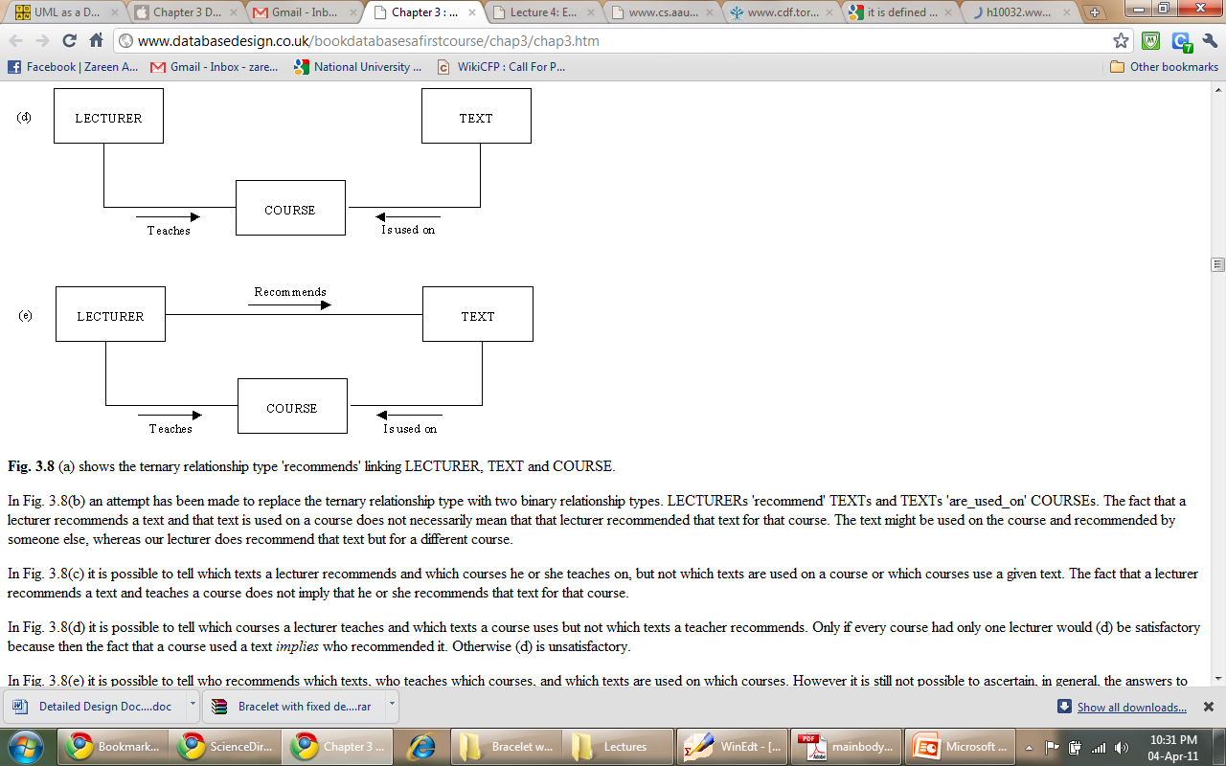
Example of a ternary relationship
Notes:
In Fig. 3.8(d) it is possible to tell which courses a lecturer teaches and which texts a course uses but not which texts a teacher recommends. Only if every course had only one lecturer would (d) be satisfactory because then the fact that a course used a text implies who recommended it. Otherwise (d) is unsatisfactory.
In Fig. 3.8(e) it is possible to tell who recommends which texts, who teaches which courses, and which texts are used on which courses. However it is still not possible to ascertain, in general, the answers to questions like:
'Which text does Mr Smith recommend for the 4th year Database course?'
The reason is that even though Mr Smith may recommend text1 and Mr Smith teaches on 4th year Database, it is not known whether it was Mr Smith who recommended the text for the course, because he may have recommended the text for another course, and another lecturer on the 4th year Database course may have recommended text1. The only satisfactory relationship type is that shown in Fig. 3.8(a).

Slide 44
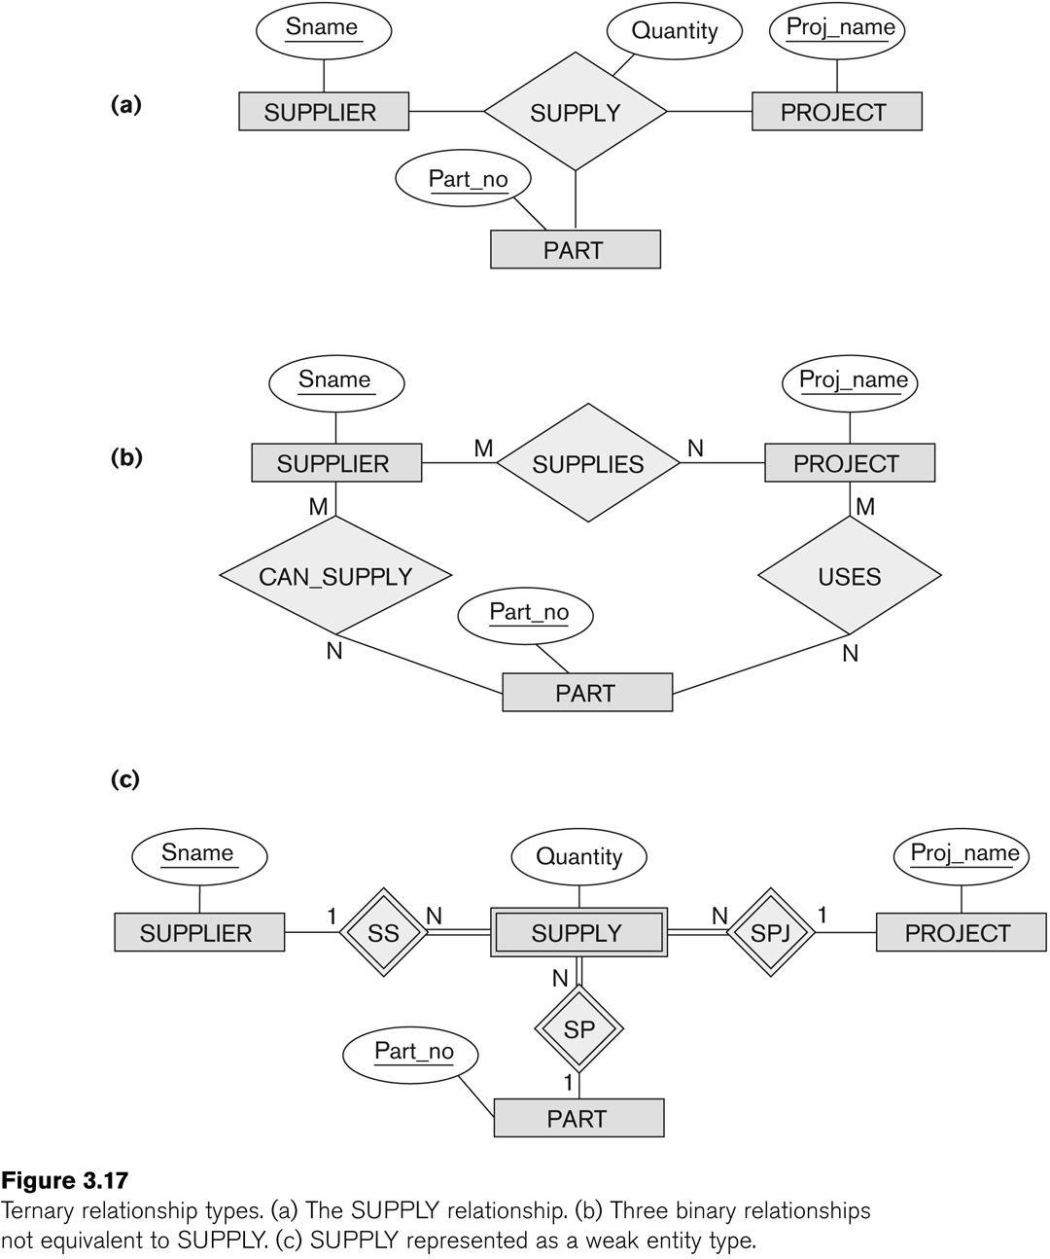
Example 2 of a ternary relationship

Slide 45
n-ary relationships (n > 2)
Three binary relationships represents different information than a single ternary relationship
In some cases, a ternary relationship can be represented as a weak

Slide 46
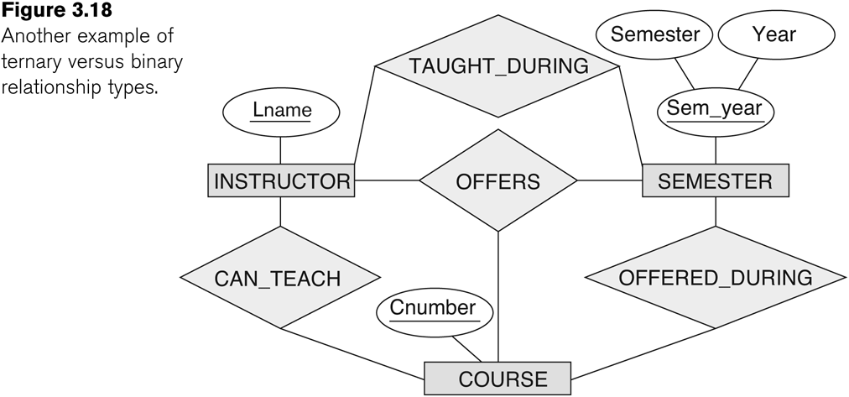
Example 3 of a ternary relationship
Notes:
For example, a relationship
instance (i, s, c) should not exist in OFFERS unless an instance (i, s) exists in
TAUGHT_DURING, an instance (s, c) exists in OFFERED_DURING, and an instance (i,
c) exists in CAN_TEACH. However, the reverse is not always true; we may have
instances (i, s), (s, c), and (i, c) in the three binary relationship types with no corresponding
instance (i, s, c) in OFFERS.Note that in this example, based on the meanings
of the relationships, we can infer the instances of TAUGHT_DURING and
OFFERED_DURING from the instances in OFFERS, but we cannot infer the
instances of CAN_TEACH; therefore, TAUGHT_DURING and OFFERED_DURING are
redundant and can be left out.

Slide 47
n-ary relationships (n > 2)
If a particular binary relationship can be derived from a higher-degree relationship at all times, then it is redundant
For example, the TAUGHT_DURING binary relationship can be derived from the ternary relationship OFFERS (based on the meaning of the relationships)

Slide 48
Displaying constraints on higher-degree relationships
Displaying a 1, M, or N indicates
1 indicates that an entity can participate in at most one relationship instance that has a particular combination of the other participating entities
M or N indicates no constraint
(min, max) constraints can be displayed on the edges – however, they do not fully describe the constraints
In general, both (min, max) and 1, M, or N are needed to describe fully the constraints

Slide 49
Cardinality for ternary relationship
Constraint: For a particular project-part combination, only one supplier will be used (only one supplier supplies a particular part to a particular project).
Notes:
In this case, we
place 1 on the SUPPLIER participation, and M, N on the PROJECT, PART participations
in Figure 7.17. This specifies the constraint that a particular ( j, p) combination
can appear at most once in the relationship set because each such (PROJECT, PART)
combination uniquely determines a single supplier. Hence, any relationship
instance (s, j, p) is uniquely identified in the relationship set by its ( j, p) combination,
which makes ( j, p) a key for the relationship set.
In this notation, the participations that have a 1 specified on them are not required to be part of the identifying
key for the relationship set. If all three cardinalities are M or N, then the key will
be the combination of all three participants.

Slide 50
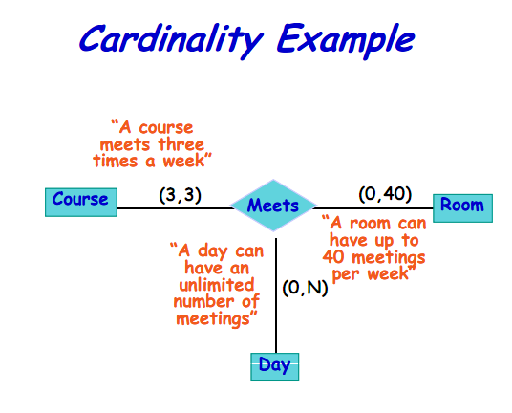
Displaying constraints on higher-degree relationships
Notes:
A (min, max) on a participation here specifies that each
entity is related to at least min and at most max relationship instances in the relationship
set. These constraints have no bearing on determining the key of an n-ary relationship,
where n > 2,17 but specify a different type of constraint that places
restrictions on how many relationship instances each entity can participate in.

Slide 51
Problem 2: ER for Notown Records
Each musician has an SSN, name, address, phone. Poor musicians often share the same address, and no address has more than one phone.
Each instrument that is used in songs recorded at Notown has a name (e.g., guitar, flute) and a musical key (e.g., C, B-flat).
Each album has a title, a copyright date, a format (e.g., CD or MC), and an album identifier.
Each song recorded at Notown has a title and an author.
Each musician may play several instruments, and an instrument may be played by several musicians.
Each album has a number of songs on it, but no song may appear on more than one album.
Each song is performed by one or more musicians, and a musician may perform a number of songs.
Each album has exactly one musician who acts as its producer. A musician may produce several albums, of course.

Slide 52
Alternative diagrammatic notation
ER diagrams is one popular example for displaying database schemas
UML class diagrams is representative of another way of displaying ER concepts

Slide 53
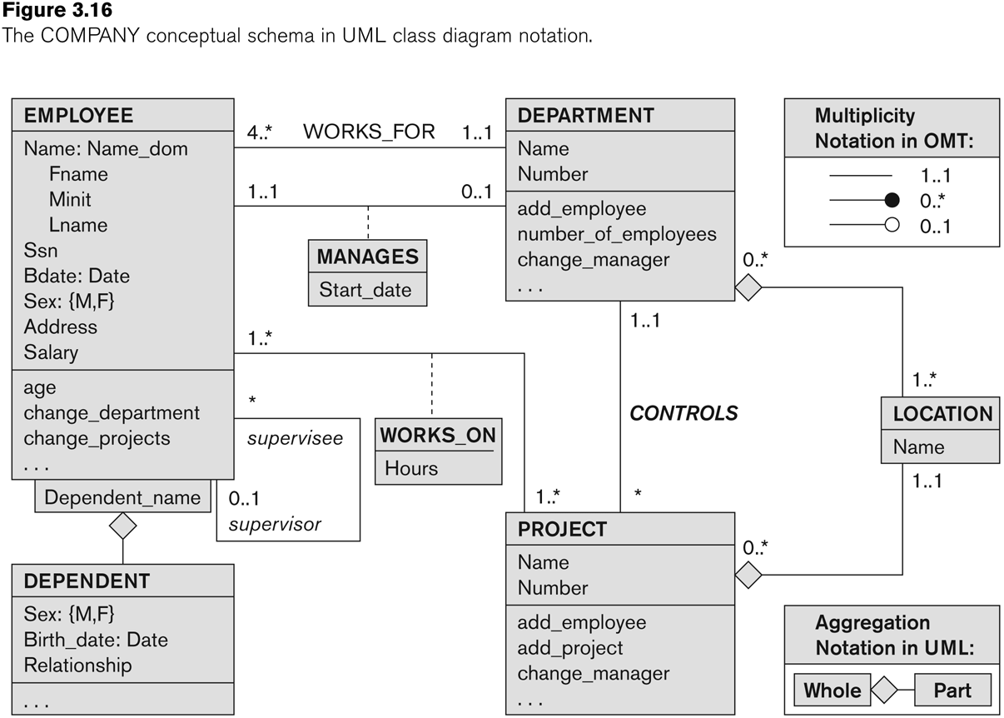
UML class diagrams
Represent classes (similar to entity types) as large boxes with three sections:
Top section includes entity type (class) name
Second section includes attributes
Third section includes class operations (operations are not specified in ER model)
Composite attribute is modeled as a structured domain
Name of EMPLOYEE
Multivalued attribute is modeled as a separate class
LOCATION class

Slide 54
UML class diagrams
Relationship types are called associations in UML
Relationship instances are called links
Relationships are represented as lines connecting the classes
The (min, max) notation is used to specify relationship constraints (multiplicities)
multiplicities are placed on the opposite ends of the relationship
A recursive relationship is called a reflexive association in UML
Weak entities can be modeled using the construct called qualified association
Notes:
the multiplicities are placed on the opposite ends of the relationship when
compared with the notation discussed in ER model

Slide 55
UML class diagram for COMPANY database schema
Qualified association for weal entity
Notes:
In UML, there are two types of relationships: association and aggregation.
Aggregation is meant to represent a relationship between a whole object and its
component parts, and it has a distinct diagrammatic notation. In Figure, we
modeled the locations of a department and the single location of a project as aggregations.
However, aggregation and association do not have different structural
properties, and the choice as to which type of relationship to use is somewhat subjective.
In the ER model, both are represented as relationships.

Slide 56
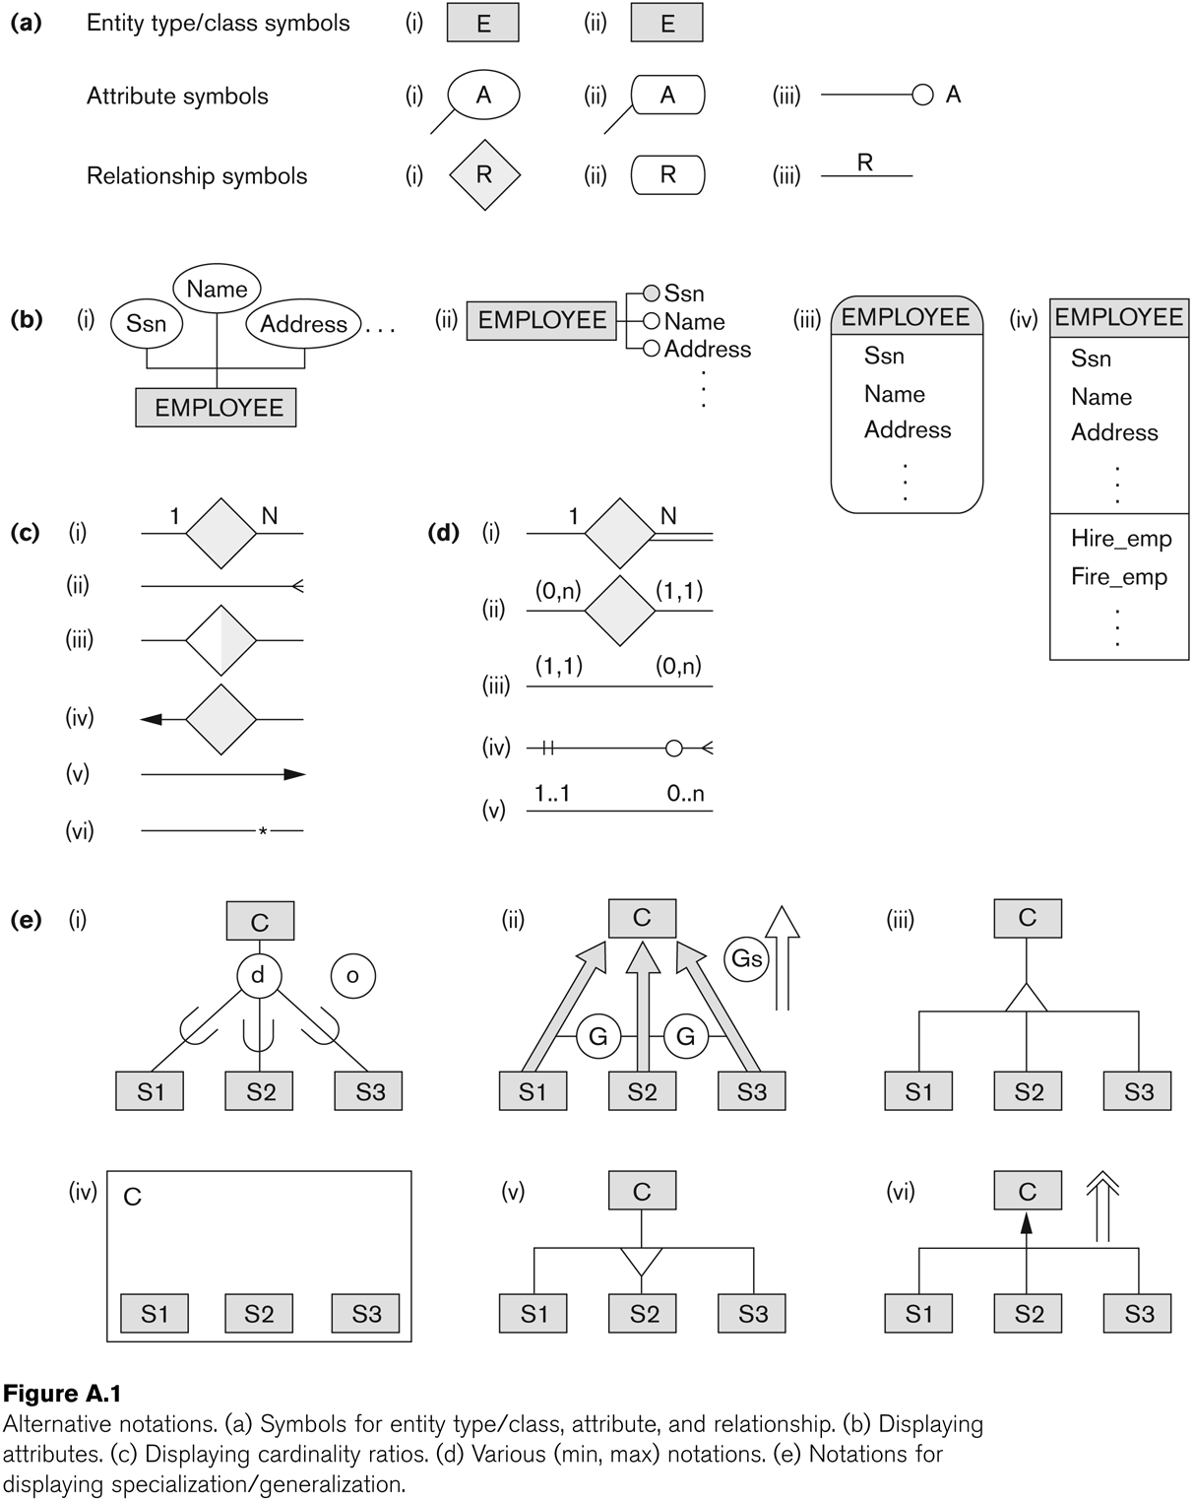
Other alternative diagrammatic notations

Slide 57
Chapter Summary
ER Model Concepts: Entities, attributes, relationships
Constraints in the ER model
Using ER in step-by-step conceptual schema design for the COMPANY database
ER Diagrams - Notation
Alternative Notations – UML class diagrams, others

